Slide 1


Computer Vision and Neural Machine Interface for Upper Limb Prostheses
Team members:
Abdelrahman Hamza
Ghadir Moemen
Hanna Nabil
Mostafa Elwafa
Supervised by:
Dr. Meena AbdelMaseeh

Slide 2
Agenda
GP sponsor: IHub.
Problem definition.
System design.
Integration algorithm.
EMG module.
CV module.
Real-time system.
System implementation.
Future sight
Gained skills.
Team contribution.

Slide 3
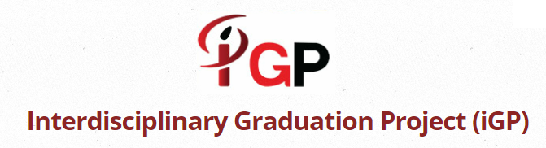

GP sponsor: IHub

Slide 4
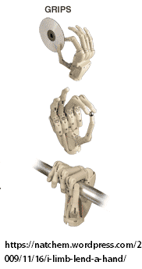
Problem definition
Amputation problem and
current status.
Transradial amputation: a story of
dexterous control.
EMG:
>Signal loss due to muscle atrophy.
Solution: hybrid control to
restore minimum function.

Slide 5
System parameters
EMG commands:
Initiation, confirm, cancel, power off.
CV grasp types:
Pinch, neutral, tripod, pronated.
Prosthetic hand modes:
Rest, preshape, grasp, release.

Slide 6
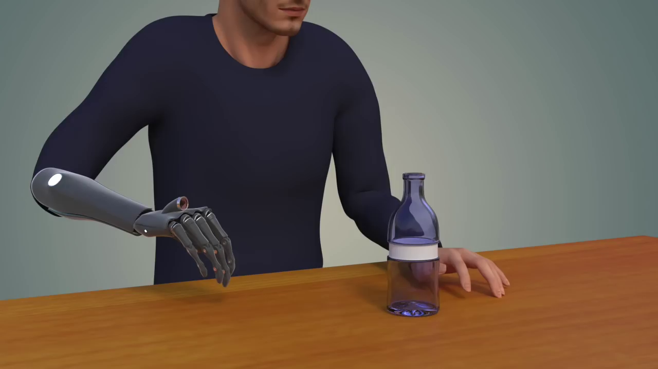
Action scenario

Slide 7
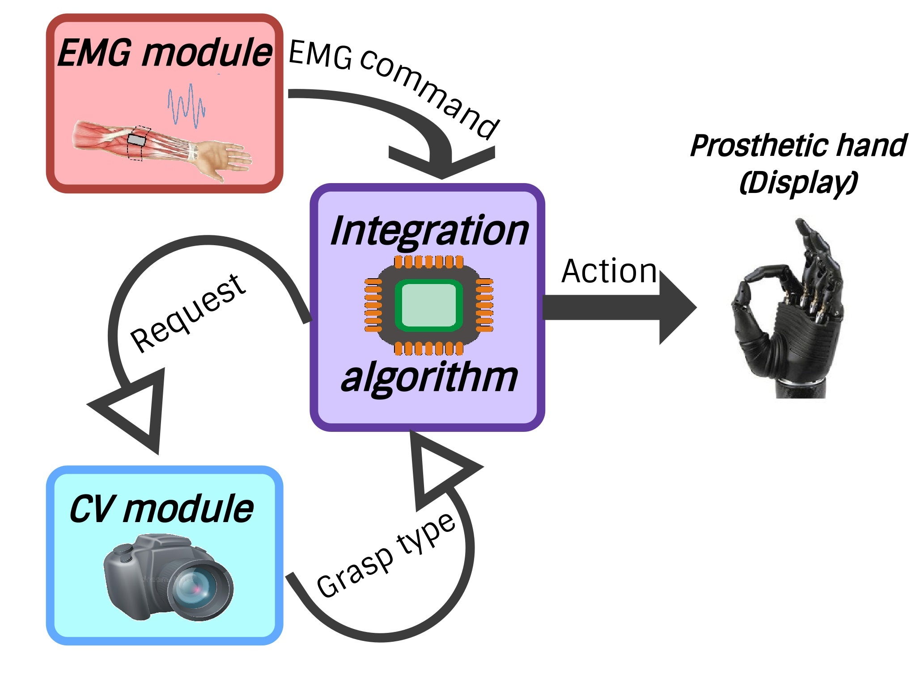
System design

Slide 8
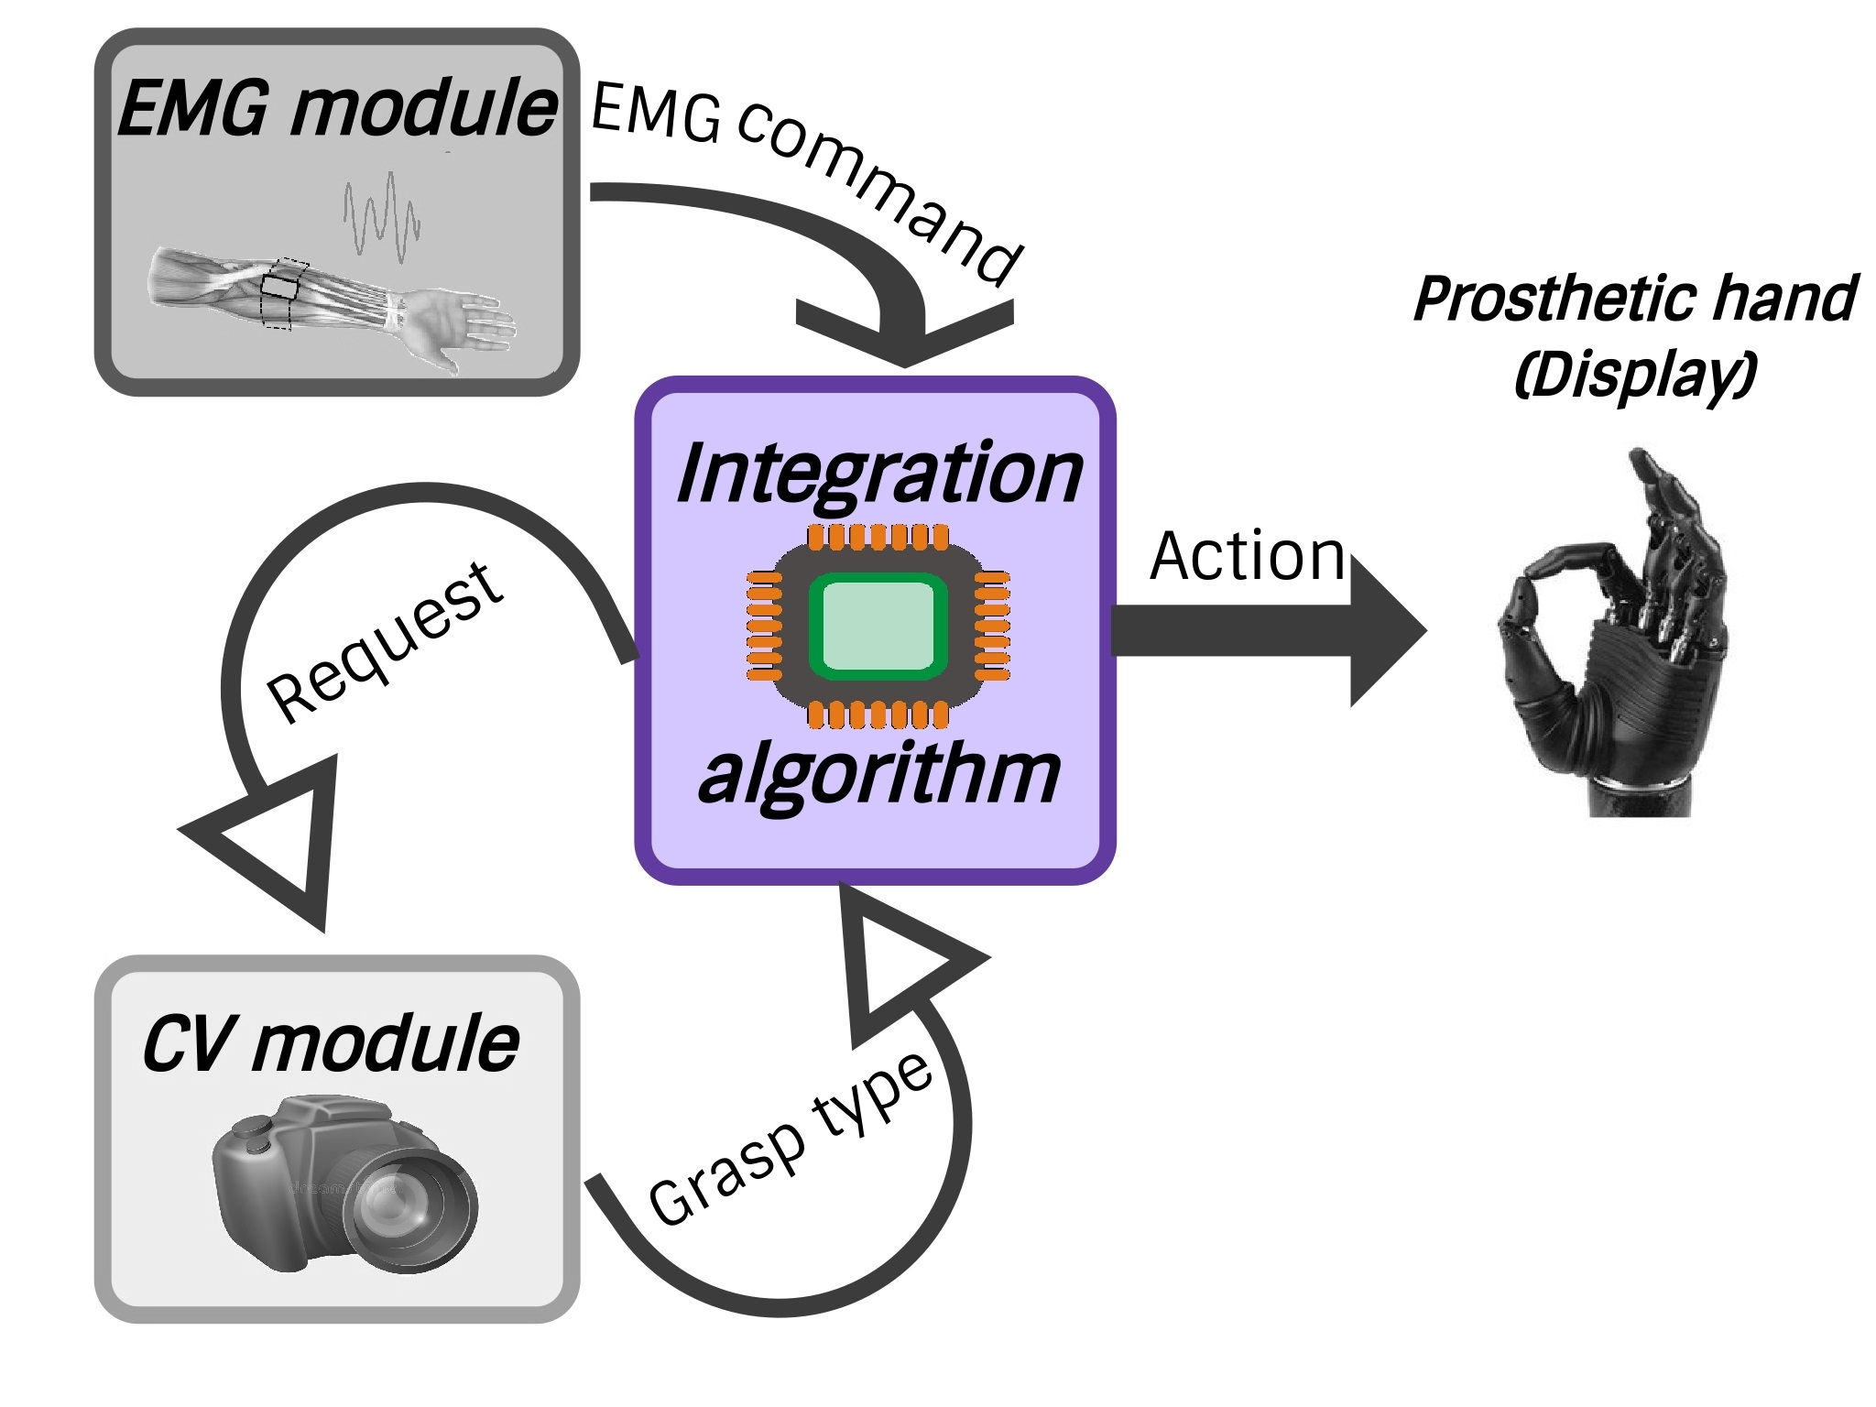
Integration algorithm

Slide 9
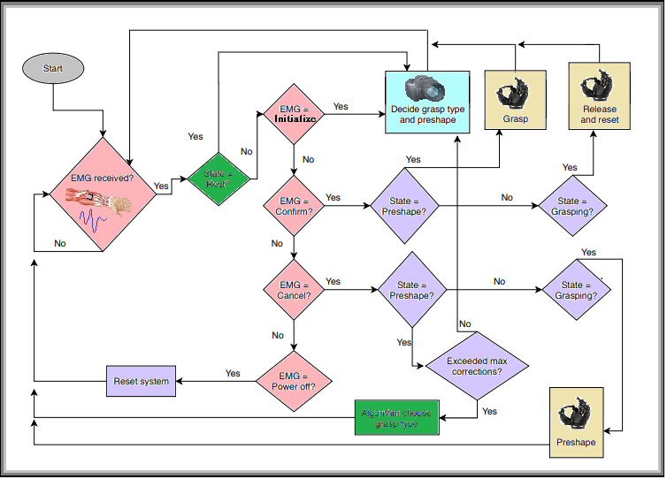
Integration algorithm
Notes:
Explain states.

Slide 10
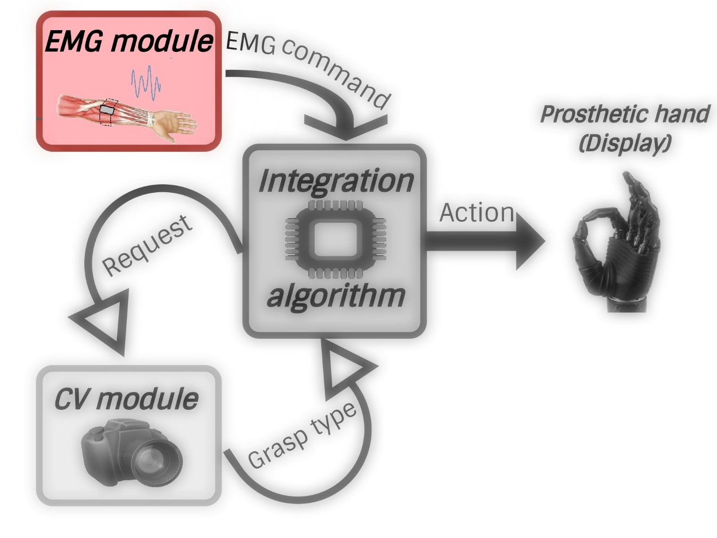
EMG Module

Slide 11
EMG Module: Block diagram
Data Windowing
Feature Extraction
EMG Dataset
Preprocessing
Feature Extraction
Class Label
Classification

Slide 12
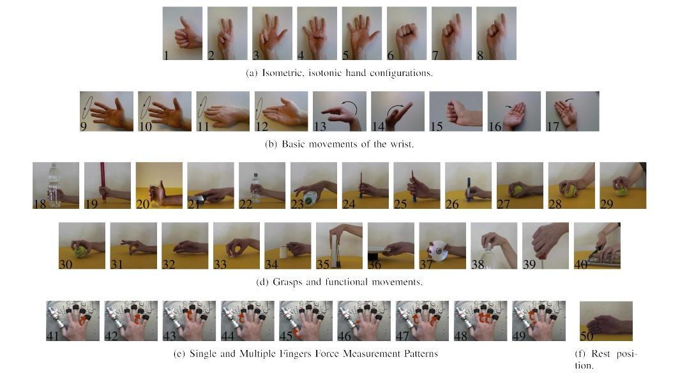
EMG Module: Dataset
NInaPro Dataset

Slide 13
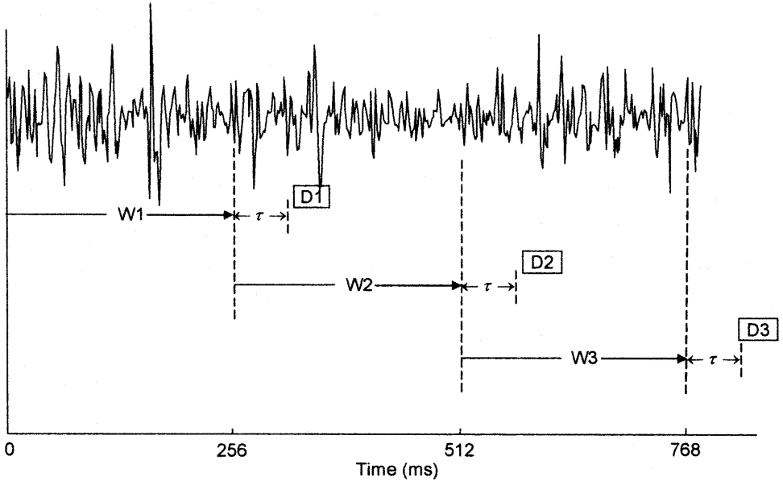
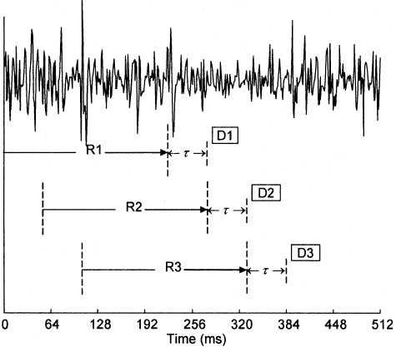
EMG Module: Methodology
Windowing of MES
Overlapping Increased Accuracy

Slide 14
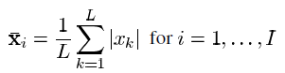


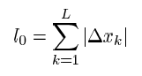
EMG Module: Feature Extraction
Mean Absolute Value
Zero Crossings
Slope Sign Changes
Waveform Length

Slide 15
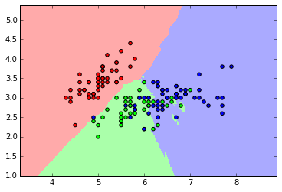
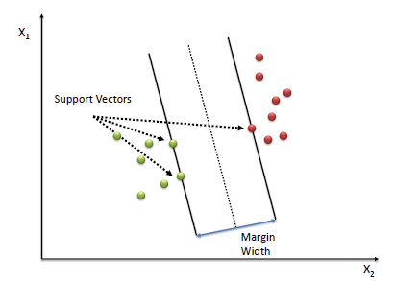
EMG Module: Classifier
KNN
SVM

Slide 16
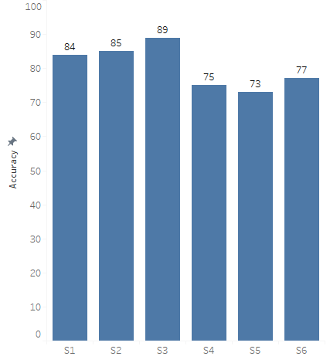
EMG Module: Results
Results of NINAPRO dataset

Slide 17
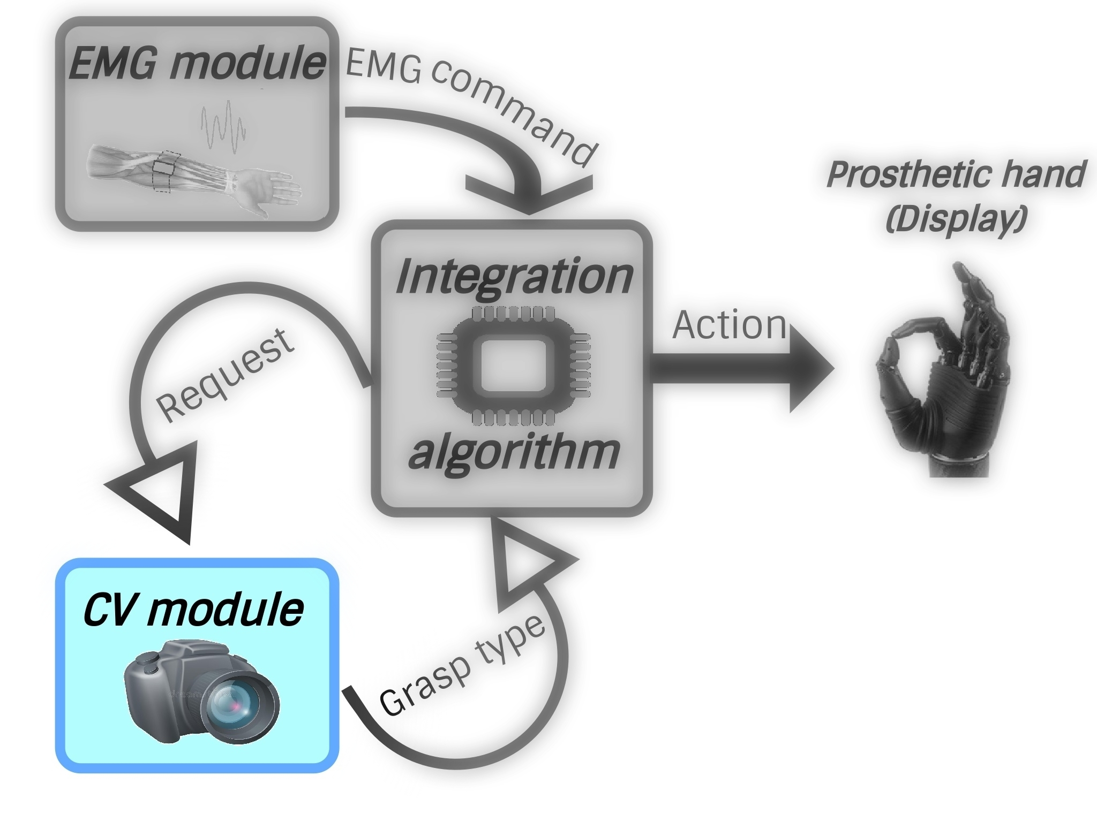
CV Module

Slide 18
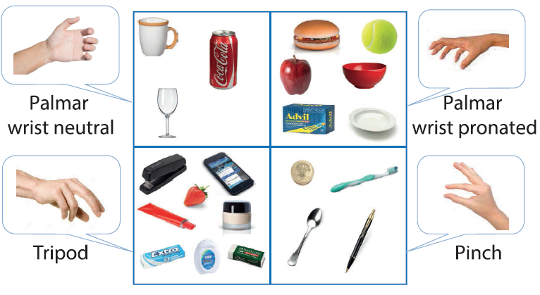

CV Module: Methodology

Slide 19
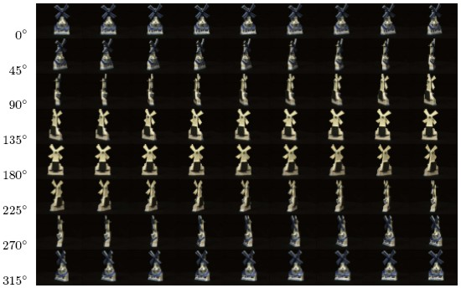
CV Module: ALOI Dataset

Slide 20
CV Module: ALOI Dataset
1000 obj → 750 obj → 473 obj
72 pictures at 5 intervals against a black background
124.5 cm distance and 30 cm altitude from the objects.

Slide 21
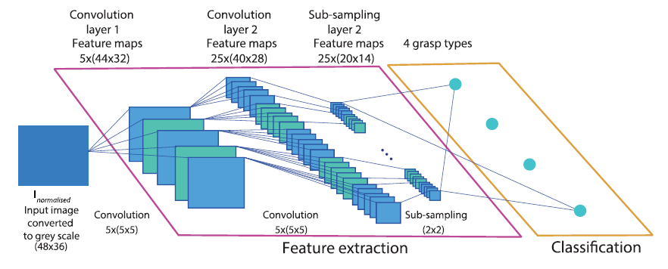

CV Module: Architecture

Slide 22
CV Module: Architecture
Preprocessing:
gray-scale → Normalization → Resize(768×576 to 36x48)
CNN Architecture, Two layers:
Five kernels (5x5) → max pooling by factor 2
Activation function: ReLU
Optimizer: Adam
Python library: Keras

Slide 23
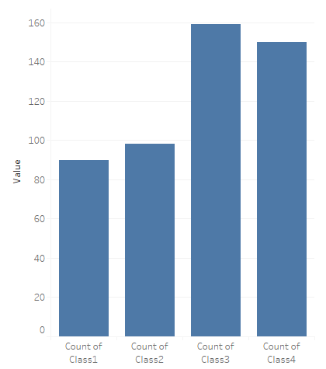
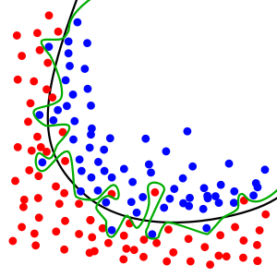
CV Module: Common Problems
Imbalanced Classes
Suggested Solution: Re-Sampling the Dataset.
Overfitting
Suggested Solution: Dropout Regularization.

Slide 24
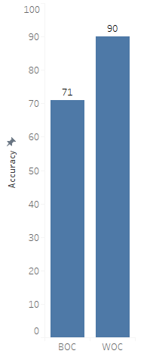
CV Module: Results

Slide 25
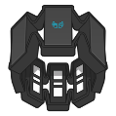
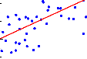
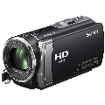
Real-time System
Computer Vision Classifier
EMG Acquisition
EMG Classifier
Camera Orders
Grasp Type
MYO ArmBand
Machine Learning Model
System Power ON
Confirmation
Cancellation
System Power OFF
Pinch
Palmar Neutral
Tripod
Palmar Pronated
Keras
(TensorFlow)
Finger Spread
Wrist Extension
Wrist Ulnar Deviation
Rest

Slide 26
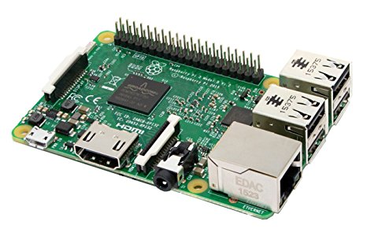
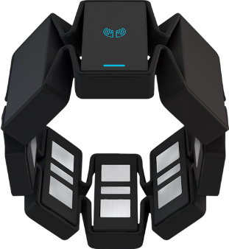
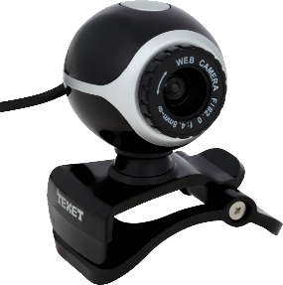
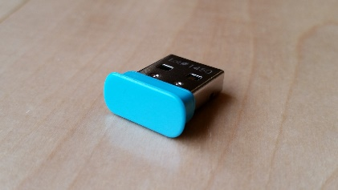
System Implementation
Components
Raspberry-Pi 3 Model B
MYO ArmBand
Raspberry Bluetooth
USB Camera
PC:
MYO ArmBand
MYO USB Bluetooth
HD Webcam Camera

Slide 27
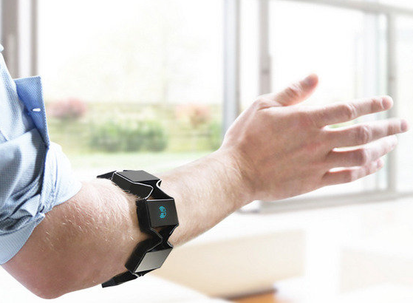
EMG Acquisition in Real-time
Open MYO
EMG Training
Our Protocol
EMG Testing
EMG Classifier in Real-time
Samples
Save File
Prepare Data
Feature Extraction
Save Model
Classifier

Slide 28
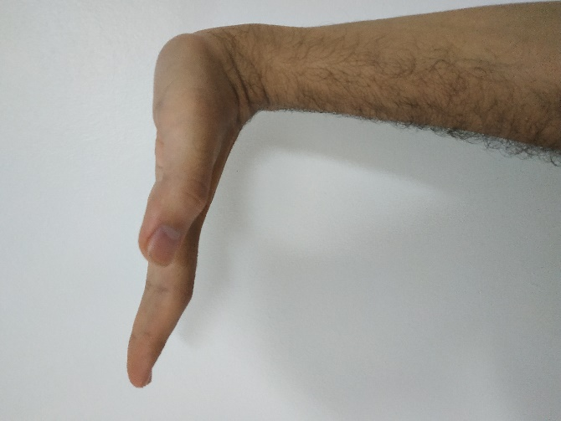
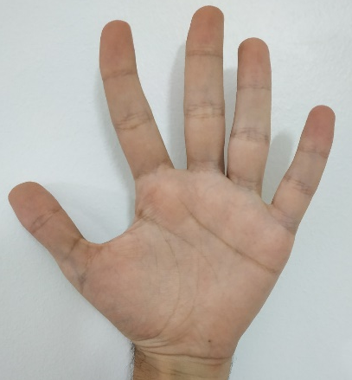
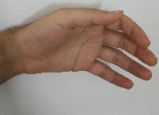
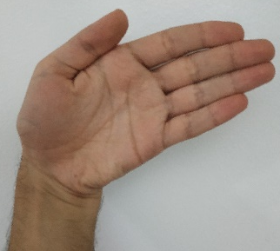
EMG Classifier in Real-time
Window From Stream
Filtration
1-Finger Spread
2-Wrist Extension
Feature Extraction
3-Wrist Ulnar Deviation
0-Rest
Prediction From Model

Slide 29

Computer Vision in Real-time
Camera Acquisition using CV2
Model built with Keras (tensorflow backend)
Problems Faced us !!
Camera Acquisition
Resize
Model Prediction
Grasp Type
Preparation

Slide 30
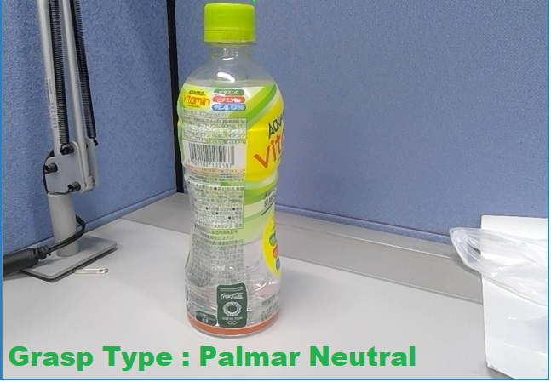
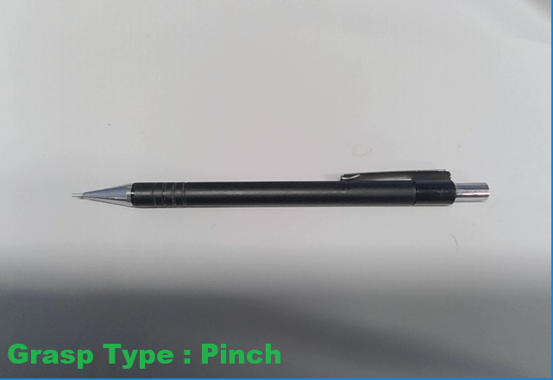
Computer Vision Results
Computer Vision Real-time Module

Slide 31
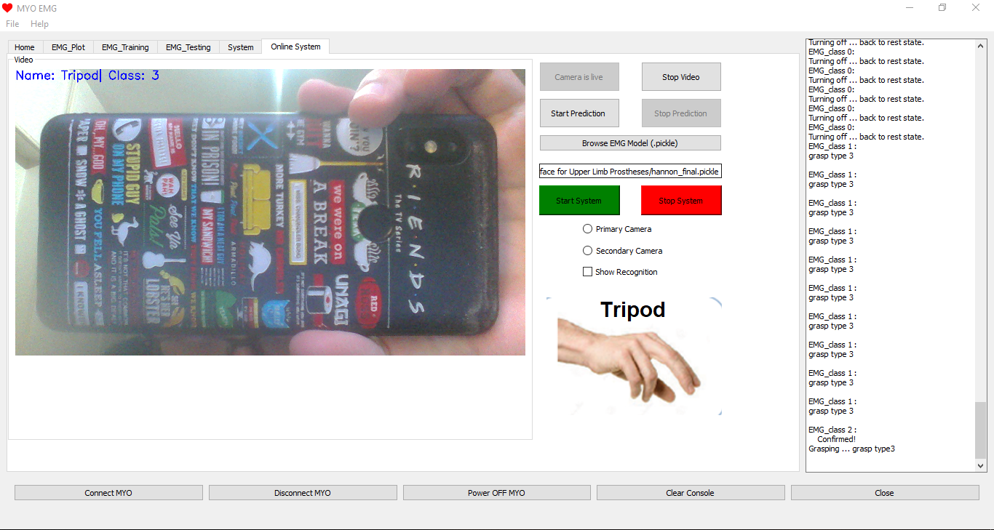
System Graphical User Interface

Slide 32
Future sight
CV module:
> Zooming effect.
> Multilayered network.
System functionality:
> Add proportional control.
> Add feedback loop.

Slide 33
Gained skills
Project management:
> Time management, teamwork, cost management … etc.
> Research and guided self learning.
Professional programming.
Data science and engineering.
Working within a multidisciplinary environment.

Slide 34
Team Contribution
 | Hamza | Ghadir | Hanna | Mostafa
Research and Reading
EMG Module
CV Module
Integration
Real-Time System
Result Visualization
Troubleshooting
IHub
External Communication
GUI & EMG Acquisition
Documentation

Slide 35
Thank you ☺

